Slide 1

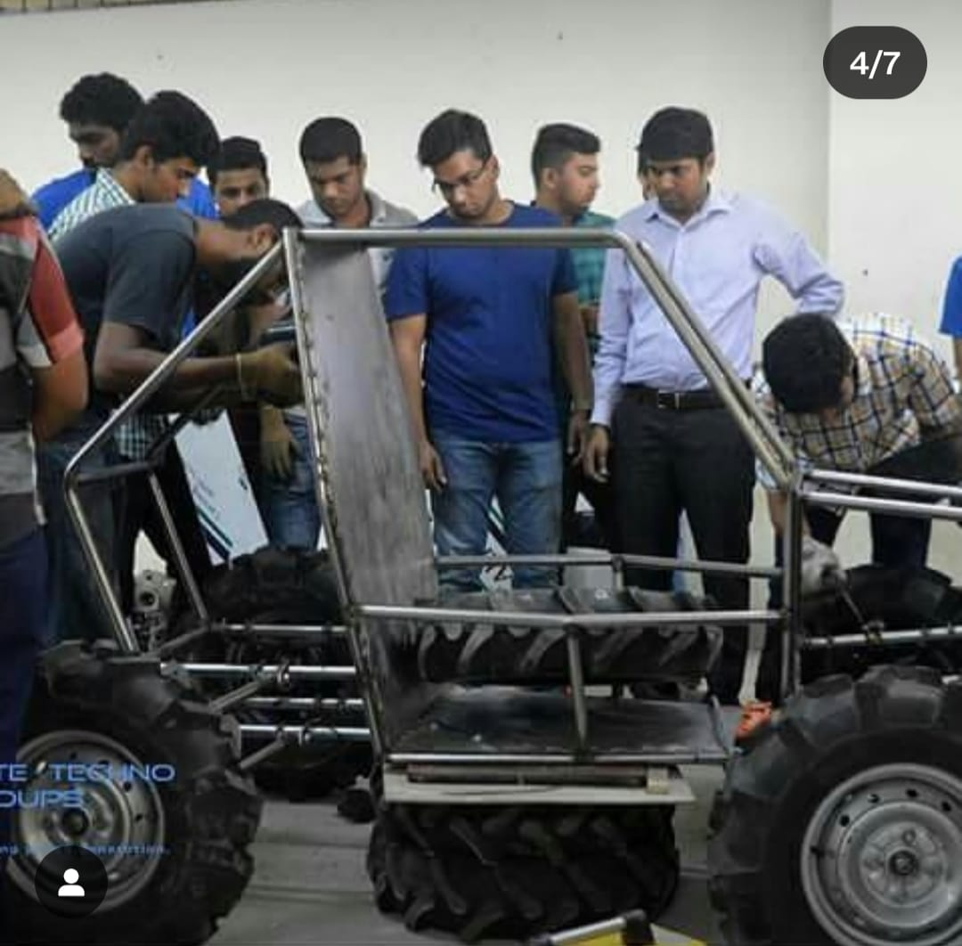
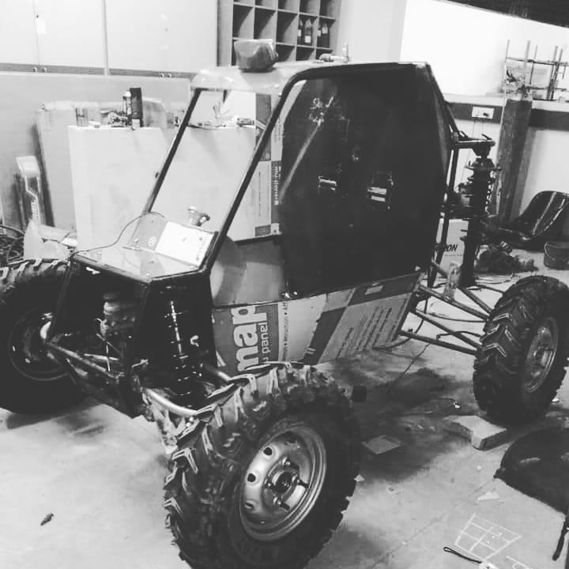
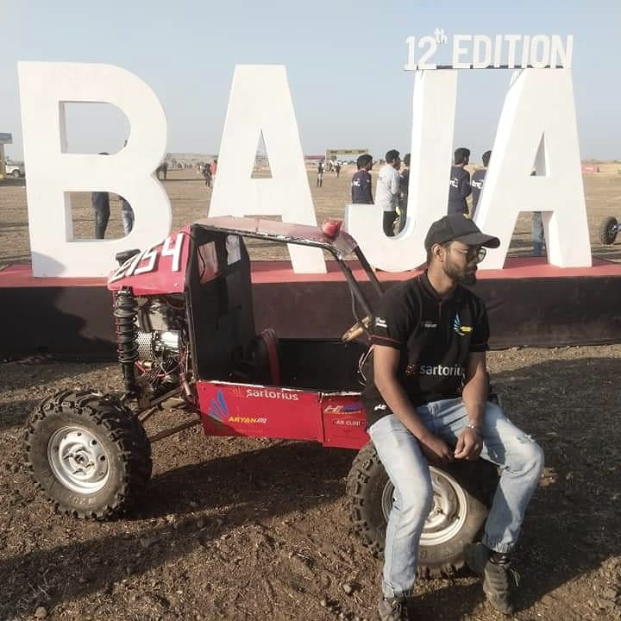
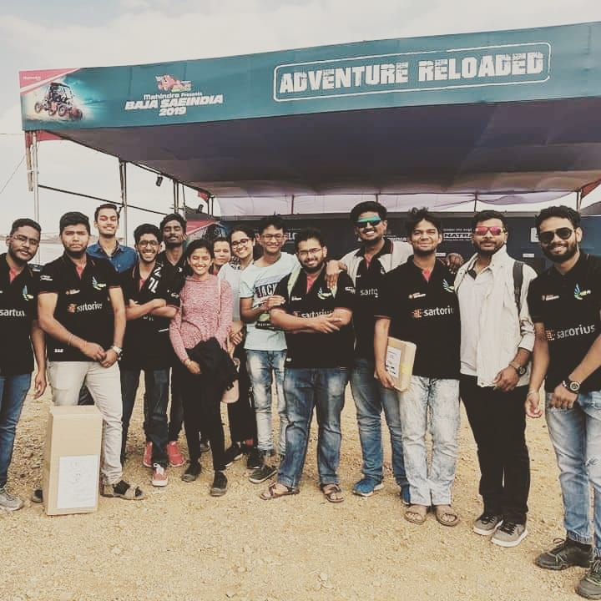
Team: Aryan Racing
REVA UNIVERSITY

Slide 2
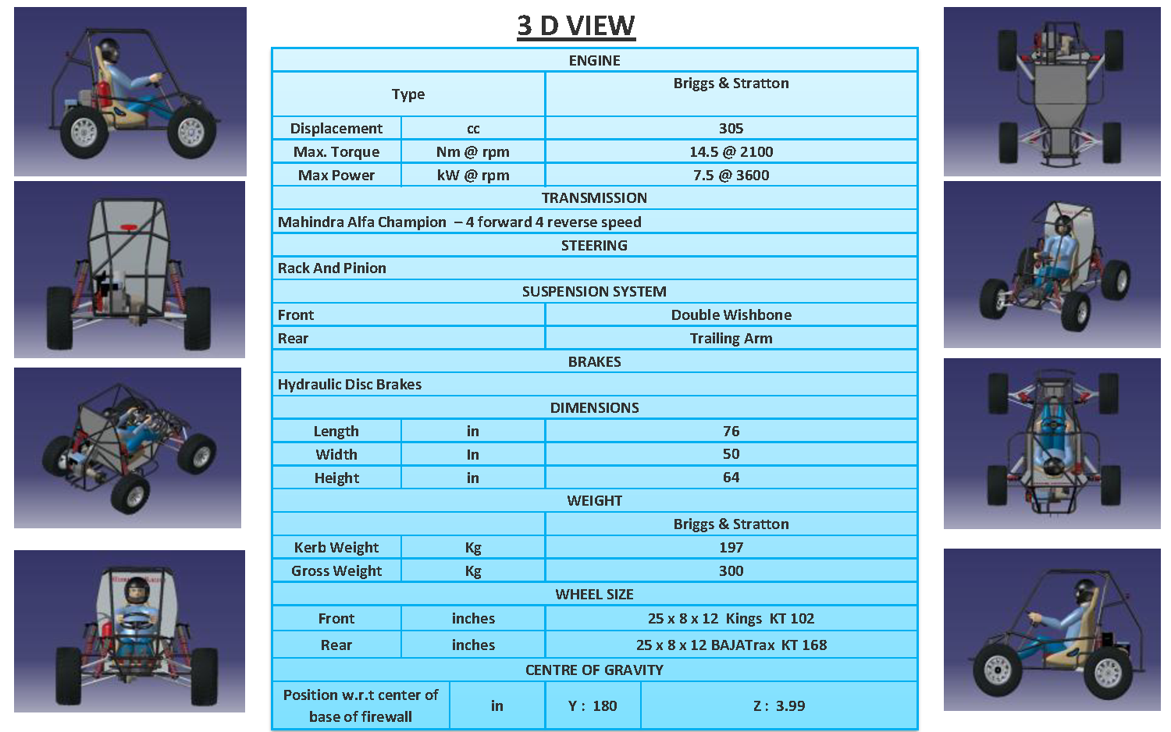
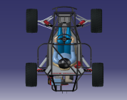
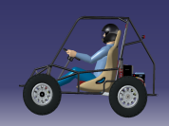
TECHNICAL SPECIFICATION
ENGINE
TYPE |  | BRIGGS & STRATTON
DISPLACEMENT | CC | 305
MAX TORQUE | NM @ RPM | 14.5 @ 2100
MAX POWER | KW @ RPM | 7.5 @ 3600
TRANSMISSION
CLUTCH | PIAGGIO APE – 4 FORWARD AND REVERSE SPEED
STEERING
RACK AND PINION
SUSPENSION SYSTEM
FRONT |  | DOBLE WISHBONE
REAR |  | TRAILING ARM
BRAKES
HYDRAULIC DISC BRAKES
DIMENSIONS
LENGTH | INCHES | 87.2
WIDTH | INCHES | 60
HEIGHT | INCHES | 54
WEIGHT
KERB WEIGHT | KG | 270
GROSS WEIGHT | KG | 330
WHEEL SIZE
FRONT | INCHES | 25 * 8 * 12
REAR | INCHES | 25 * 8 * 12
CENTRE OF GRAVITY
POSITION FROM CENTRE OF BASE OF FIREWALL | INCHES | Y: 37.8 | Z: 13.82

Slide 3
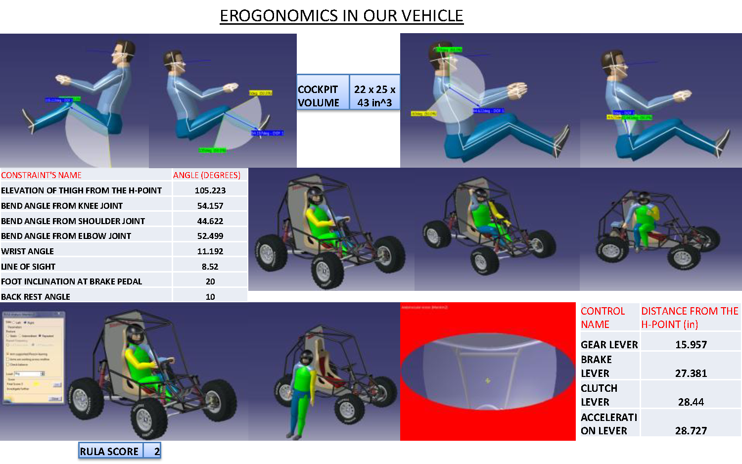
EROGONOMICS OF OUR VEHICLE
DESIGN METHODOLOGY
Requirements
Analysis
Design
Testing
Acceptance
CONSTRAINT’S NAME | ANGLE(DEG)
ELEVATION OF THIGH FROM THE H-POINT | 105.22
BEND ANGLE FROM KNEE JOINT | 54.157
BEND ANGLE FROM SHOULDER JOINT | 44.62
BEND ANGLE FROM ELBOW JOINT | 52.49
WRIST ANGLE | 11.19
LINE OF SIGHT | 8.52
FOOT INCLINATION AT BREAK PEDAL | 20
BACK REST ANGLE | 10
RULA SCORE = 2
CONTROL NAME | DISTANCE FROM THE H-POINT(IN)
GEAR LEVER | 15.95
BREAK LEVER | 27.38
CLUTCH LEVER | 28.44
ACCELERATION LEVER | 28.727

Slide 4
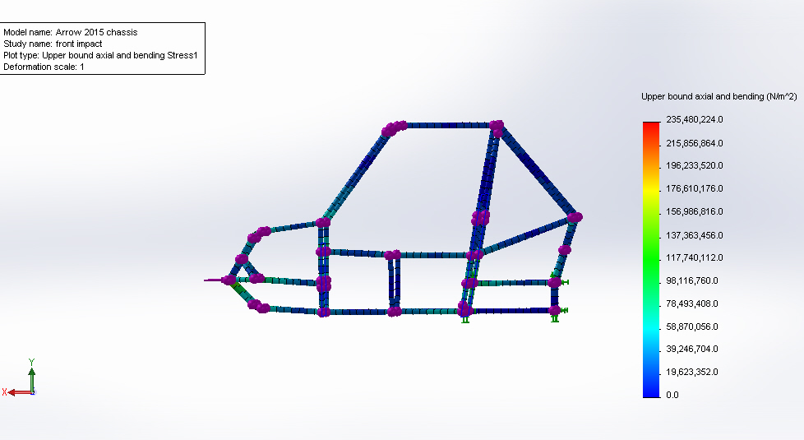
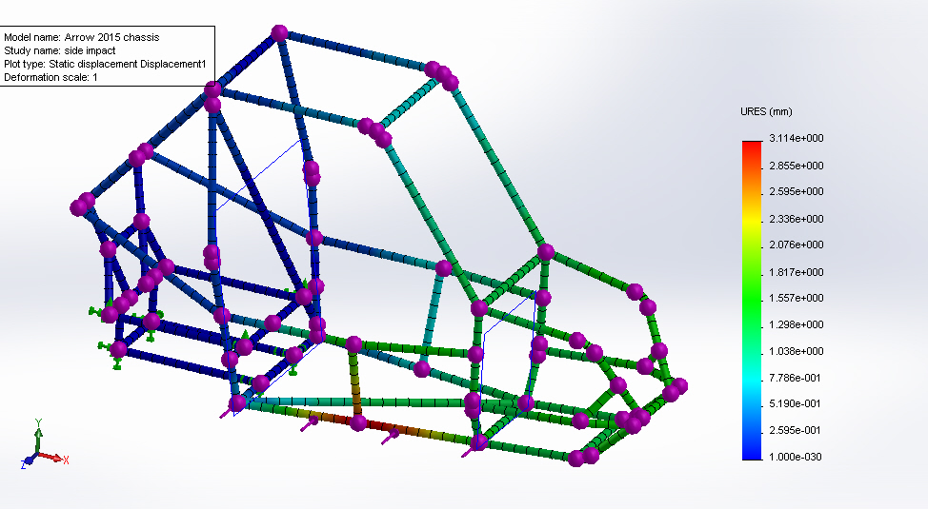
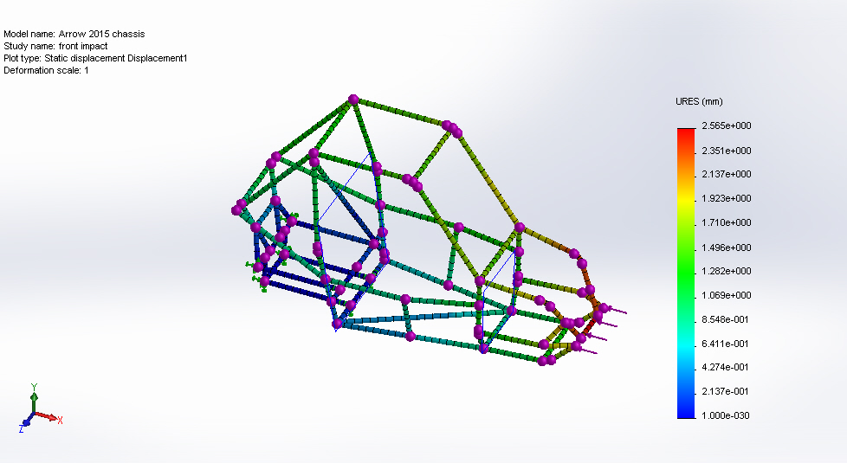
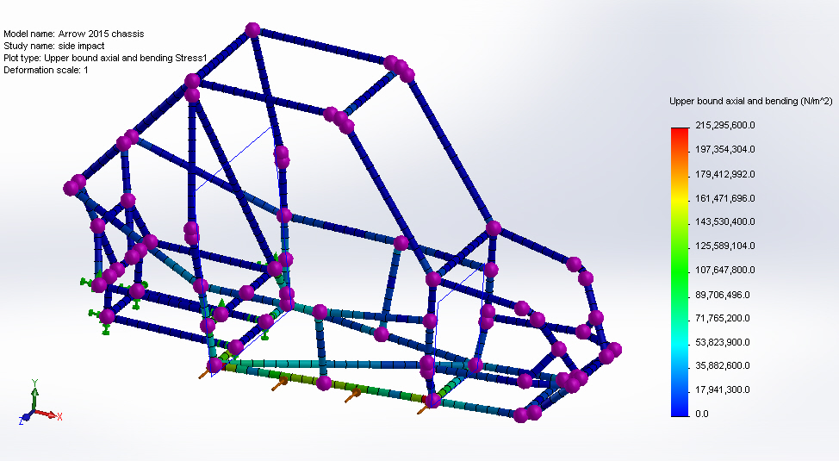
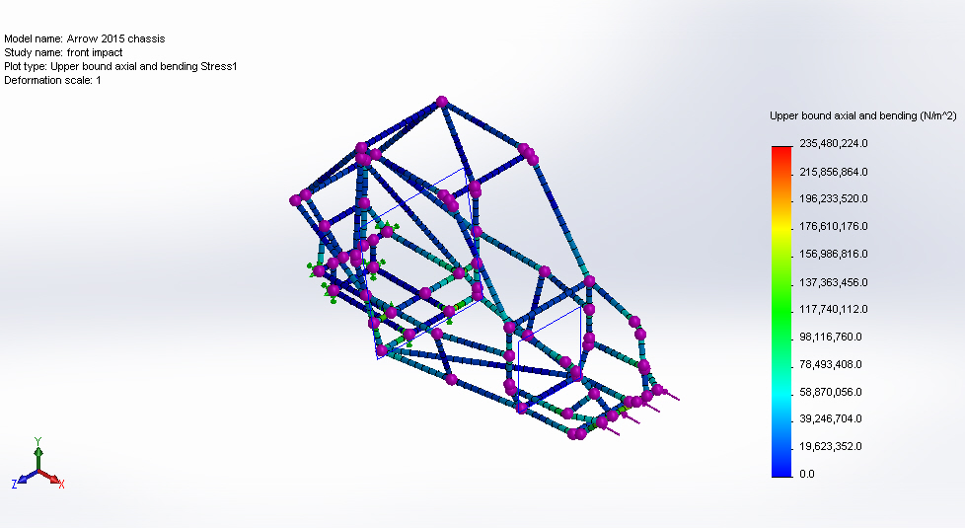
ROLL CAGE ANALYSIS
MATERIAL SELECTED | AISI 4130
YIELD STRENGTH | 460 MPA
TENSILE STRENGTH | 560 MPA
CONDITION | FRONT IMPACT | SIDE IMPACT | REAR IMPACT | ROLL OVER
FORCE(G) | 4g | 2g | 4g | 2g
STRESS (MPA) | 235.28 | 215.29 | 198.6 | 8.55
DISPLACEMENT (mm) | 2.56 | 3.11 | 2.05 | 1.09
F.O.S | 2.3 | 2.6 | 2.81 | 6.7
PRIMARY MEMBER | 25.4 mm OD 3mm THICKNESS
SECONDARY MEMBER | 25.4 mm OD 2mm THICKNESS

Slide 5
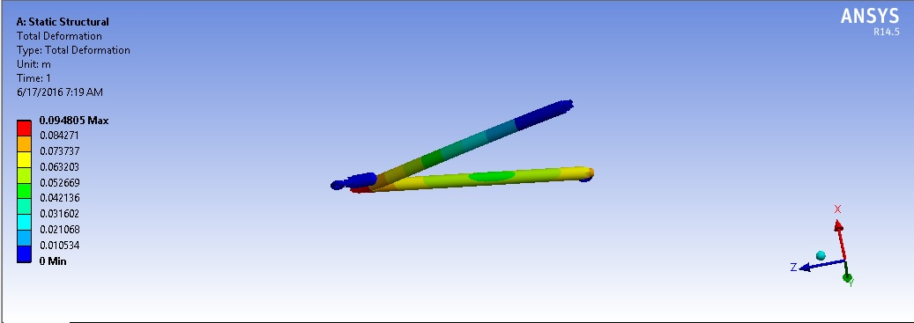
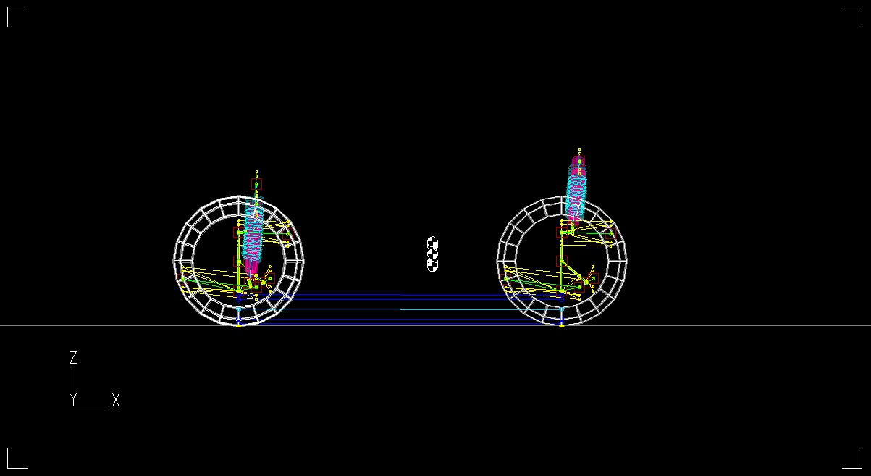
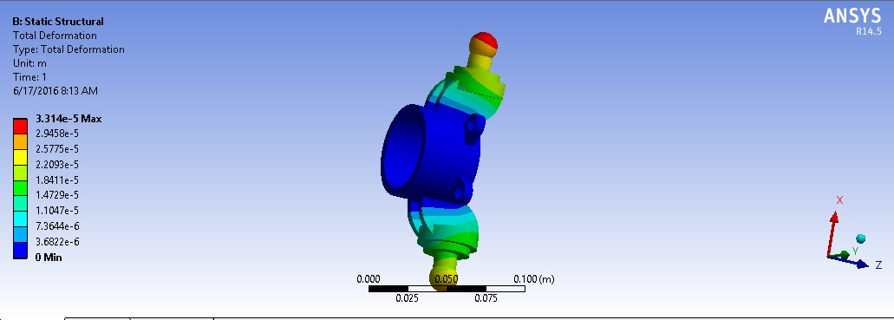
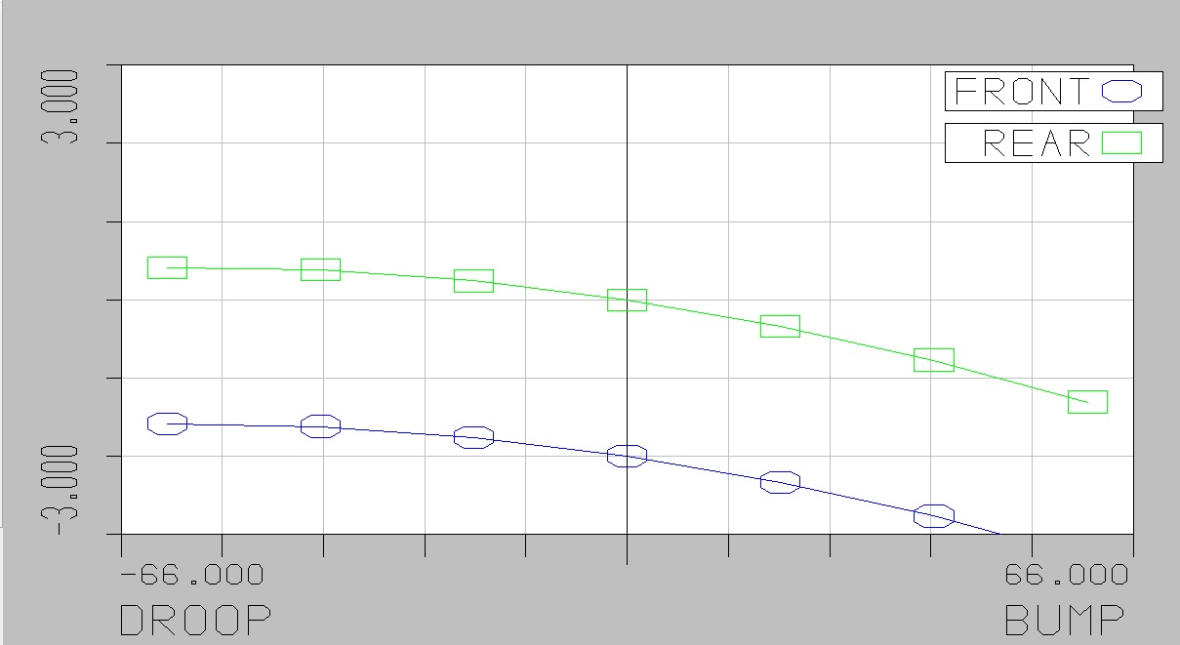
SUSPENSION SYSTEM
FRONT/REAR CONFIGURATION
TYPE | DOUBLE WISHBONE/ TRAILING ARM
ROLL CENTRE HEIGHT FROM GROUND | 33cm
LENGTH OF FRONT UPPER ARM | 28cm
LENGTH OF FRONT LOWER ARM | 42cm
LENGTH OF REAR UPPER ARM | 31cm
LENGTH OF REAR LOWER ARM | 45cm
CUSTOM KNUCKLE AND HUB
DAMPER | OUTSOURCING
SPRING | VARIABLE PITCH SPRING
SPRING STIFFNESS | 50N/65.3N
BUSHING | OUTSOURCING
PARAMETER | VALUE
TRACK WIDTH | 52”
WHEEL BASE | 62.2”
ROLLING FORCE | 2.2g
KPI | 14°
CAMBER | 5° +VE
TOE IN | 1°
CASTOR | 2° -VE
GROUND CLEARANCE | 12”
STATIC CAMBER SET TO ZERO
STATIC TOE SET TO ZERO
PARAMETER | CONTROL ARM | UPRIGHT
DISPLACEMENT | 0.0948mm | 0.0331mm
F.O.S | 2.42 | 3.21

Slide 6
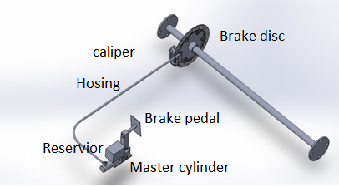
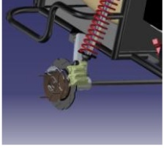
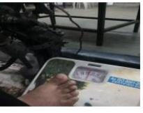
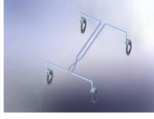
BRAKE SYSTEM
PARAMETER | VALUE
 | FRONT | REAR
BRAKE FORCE | 400N | 400N
RADIUS OF GYRATION | 0.182 | 0.269
MOMENT OF INERTIA | 0.44 | 1.02
BRAKING TORQUE | 250NM | 248NM
DISC DIMENSION(OD) | 200mm | 200mm
DISC (ID) | 78mm | 78mm
Pitch circle diameter | 92 | 92
CALIPER | Apache Front | Apache front
Diameter of piston | 25mm | 25mm
Tandem master cylinder | MARUTHI OMNI
Piston diameter | 27mm
Pedal force | 166.6
Leverage | 6
Dynamic weight transfer | 70.6kg
Stopping distance | 8.3m
Temperature rise | 62.1 | 27
PEDEL TEST
DISC ASSEMBLY

Slide 7
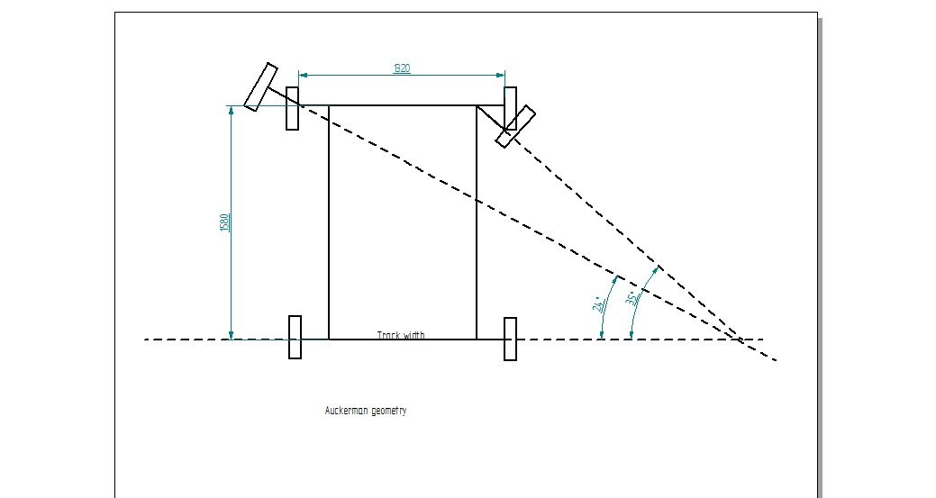
STEERING SYSTEM
Steering Type | Rack and pinion (Gear box type)
Torque at Steering arm | 52 Nm
Caster Angle | 5 degree pos
Camber angle | 2 degree -VE
Toe in | 1 degree front
KPI | 12 degree
Scrub Radius | 5mm
Component | Data | Details | Material
Rack | Travel- 3” | Total no of teeth : 20 Total length : 15” | AISI4130
Pinion | Pitch D: 25 mm | Pressure angle: 20 Addendum : 1.5 Deddendum1.875 mm Module :1.5 mm Clearance : 0.375 mm Working depth : 3 mm Total depth: 3.375 mm Teeth thickness: 2.3mm | AISI 4130 (SURFACE HARDENING)
Steering wheel | DIA – 12” |  | SEAMLESS PIPE
Tie rod column | 12” 15” |  | SEAMLESS PIPE
Steering angle 99.3 % ackerman | Inner wheel : 35 ° Outer wheel :23.84°
Steering Ratio | 5:1
Turning Radius | 3.1 m
Max effort (driver) | 120 N

Slide 8
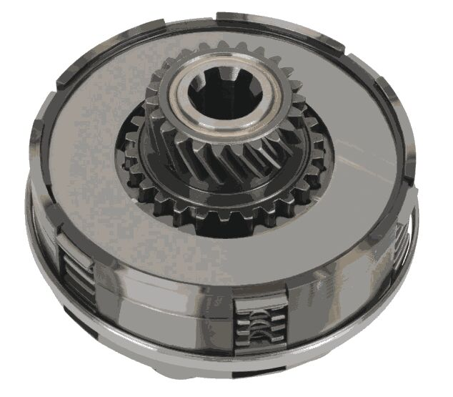
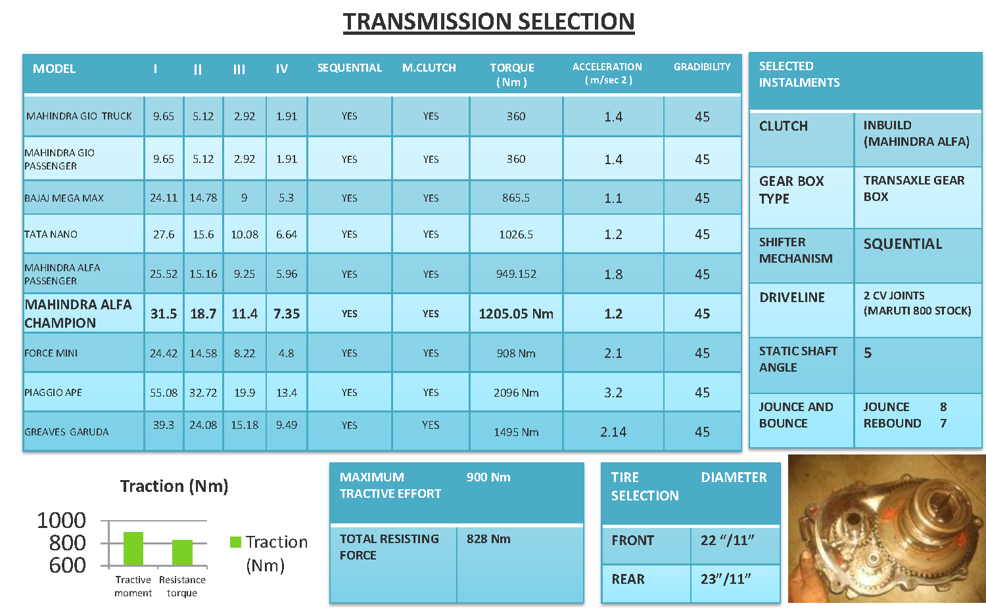
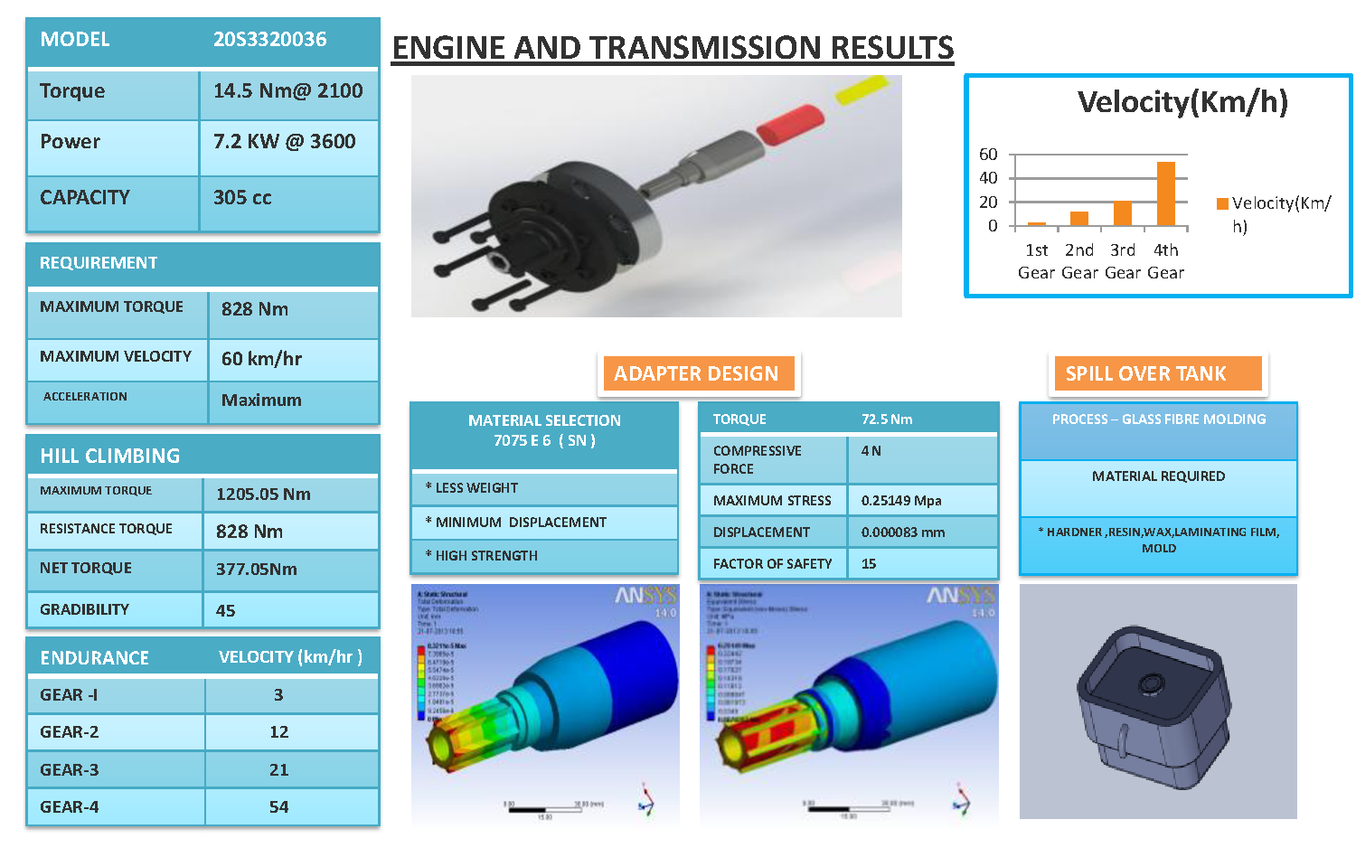
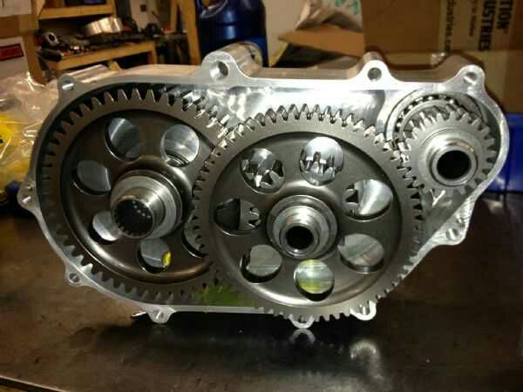
MODEL
TORQUE | 14.5Nm @ 2100RPM
POWER | 7.2KW @ 3600RPM
CAPACITY | 305 CC
POWER TRAIN
SELECTED INSTALMENTS
CLUTCH | PIAGGIO APE
GEAR BOX TYPE | TRANSAXLE GEAR BOX
SHIFTER MECHANISM | SEQUENTIAL
DRIVELINE | 2 CV JOINTS
STATIC SHAFT ANGLE | 5
REQUIREMENT
MAX TORQUE | 828Nm
MAX VELOCITY | 60 Km/h
ACCELERATION | 7.542 MAX
HILL CLIMBING
MAX TORQUE | 1090.1Nm
RESISTANCE TORQUE | 828Nm
NET TORQUE | 377.05Nm
GRADABILITY | 45
ENDURANCE | VELOCITY (KM/HR)
GEAR-1 | 9.44
GEAR-2 | 20.06
GEAR-3 | 32.98
GEAR-4 | 48.90
TIRE SELECTION | DIAMETER
FRONT | 25”/8”
REAR | 25”/8”
TRANSMISSION SELECTION
MODEL | I | II | III | IV | SEQUENTIAL | M.CLUTCH | TORQUE(Nm) | ACCELERATION (m/SEC2) | GRADABILITY
PIAGGIO APE | 47.88 | 22.54 | 13.71 | 9.24 | YES | YES | 909.80 | 1.44 | 45

Slide 9
COST AND WEIGHT ANALYSIS
COST ANALYSIS PIE CHART
WEIGHT ANALYSIS PIE CHART

Slide 10
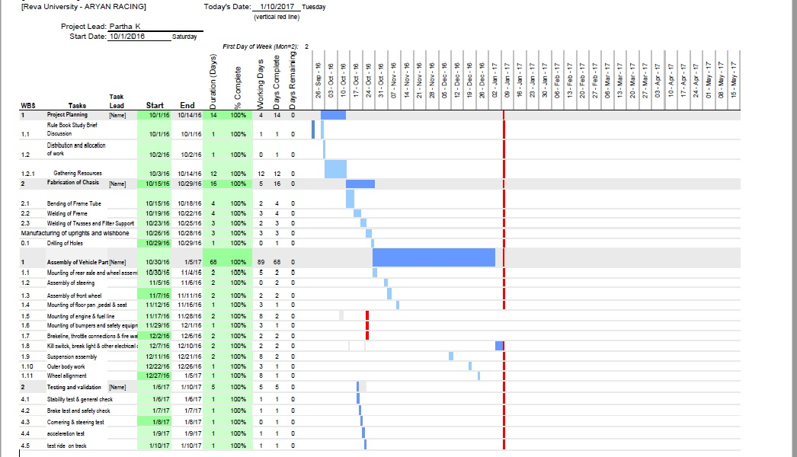
PROJECT PLAN
Planning type | Duration
Project planning | 1/10/16 To 14/10/16
Fabrication | 15/10/16 To 29/10/16
Assembly Of parts | 30/10/16 To 5/1/17
Testing and validation | 6/1/17 To 10/1/17

Slide 11
DFMEA
SLNO | COMPONENT | FAILURE MODE | FAILURE CAUSE | FAILURE EFFECT | S | O | D | RPN | PREVENTIVE ACTIONS
1 | FRAME | STRUCTURAL FAILURE. BENDING AND BREAKING OF FRAME | AXIAL STRESS EXCEEDS YIELD STRESS OF MATERIAL DUE TO EXCESS LOAD AND IMPACT LOAD | OVERALL DAMAGE TO ROLL CAGE FRAME BREAKS OR BENDS. DRIVER’S SAFETY IS EROGOMOMICS | 10 | 6 | 7 | 420 | CHOOOSE MATERIAL WITH APPROPRIATE FOS, EFFECTIVE DESIGN AND ANALYSIS. CONATANT TESTING
2 | ENGINE | MECHANICAL FAILURE, ENGINE COMPONENT DAMAGE | UNAVAILABILITY CLEAN AIR AND PROPER FAILURE | VEHICLE BECOME INOPERABLE DUE TO ENGINE FAILURE | 9 | 3 | 4 | 108 | THE ENGINE POSITION SHOULD BE SUCH THAT IT HAS FREE ACCESS TO AIR
3 | TRANSMISSION | MECHANICAL FAILURE | FATIGUE/CYCLIC LOAD | VEHICLE BECOMES INOPERABLE | 8 | 2 | 4 | 64 | CHOOSE TRANSMISSION SYSTEM ACCORDING TO GIVEN LOAD
4 | DAMPER AND SHOCK ABSORBER | MECHANICAL FAILURE, LEAKING OF SUSPENSION OIL | CYLINDER DAMAGE DUE TO FOREIGN BODY/DEBRIS | DAMAGE TO SUSPENSION SYSTEM AND ROUGH OF THE VEHICLE | 6 | 2 | 2 | 24 | VERIFICATION OF SPECIFICATIONS AND TESTING
5 | RACK AND PINION | MECHANICAL FAILURE,LEAKING OF FLUID, LOOSING OF LUNG NUT | OBSTRUCTION IN MOVEMENT OF PINION OVER RACK, DAMAGE TO COMPONENTS | STEERING FAILURE, SAFETY OF DRIVER AND OTHERS COMPROMISED | 9 | 5 | 7 | 315 | VERIFICATION OF DESIRED SPECIFICATION AND TESTING
6 | SPRINGS | SPRING FRACTURES AND FAILURE | DUE TO FAULTY CHOICE OF SPRINGS, SPRING FAILS DUE TO LOADS EXCEEDING YIELD STRESS | DAMAGE TO SUSPENSION SYSTEM AND ROUGH OF THE VEHICLE | 6 | 1 | 3 | 18 | CHOOSE SPRINGS ACCORDING TO VEHICLE LOADS AND OTHER SPECIFICATIONS
7 | A-ARM AND TRAILING ARM | BENDING BREAKAGE, CRACKS, STRUCTURAL DAMAGE AND FAILURE | AXIAL STRESS EXCEEDS YIELDING STRESS OF MATERIAL DUE TO EXCESS LOAD AND IMPACT LOAD | DAMAGE TO SUSPENSION SYSTEM AND ROUGH OF THE VEHICLE | 8 | 7 | 7 | 392 | CHOOSE MATERIAL OF HIGH FOS & ACCORDING TO VEHICLE SPECIFICATION
9 | BRAKING SYSTEM | MECHANICAL FAILURE | NOT SUFFICIENT BRAKING FORCE | DAMAGE TO VEHICLE IN UNDESIRED CIRCUMSTANCES | 9 | 5 | 3 | 135 | CHOOSE MATERIAL WITH HIGH FOS AND CAREFUL TESTING

Slide 12
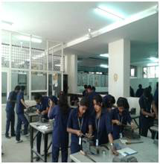
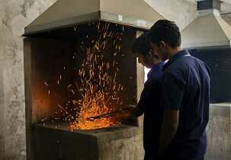
TEAM COMPOSITION
Sl. No | Name | WORK ALLOCATED
1 | SHAMANTH CHARAN KUMAR COLLIN KAUSHIK ANAND | Breaking system
2 | OMKAR MURTHY ABHISHEK DEBARSHI DAS SUMAN | Steering system
3 | DHANANJAY MADHAB ARFATH ADRIAN VIMAL | Suspension
4 | PARTHA.K SYED ABDHUL SWAROOP.U SOWRABH SHETTY | Chassis
5 | VISHAL ALZAID SYED FAIZAL VARUN | Transmission
6 | SWAROOP K S YESHWANTH SIRISH | Electrical
WORKSHOP FACILITIES PROVIDED BY OUR COLLEGE:
LATHE
DRILLING
MILLING
WELDING
GRINDING
TEAM ARYAN
Procurement team
Technical Team
Sponsorship team
Disciplinary team
Steering
VARADARAJ.K.R
(FACULTY ADVISOR)
Chassis
Brakes
Transmission
Electrical
suspension

